Slide 1
END TERM EXAMINATION PROJECT
DINKAR MAHAJAN
GROUP-22
2010991536

Slide 2

Home Page

Slide 3
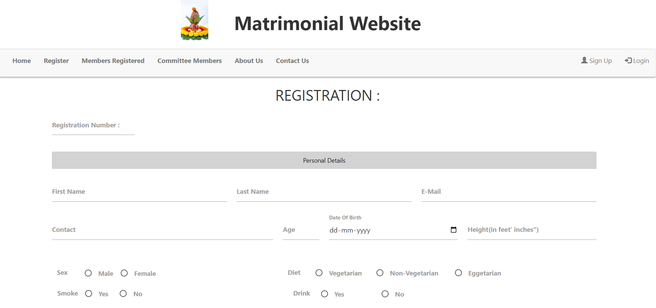
Registration

Slide 4
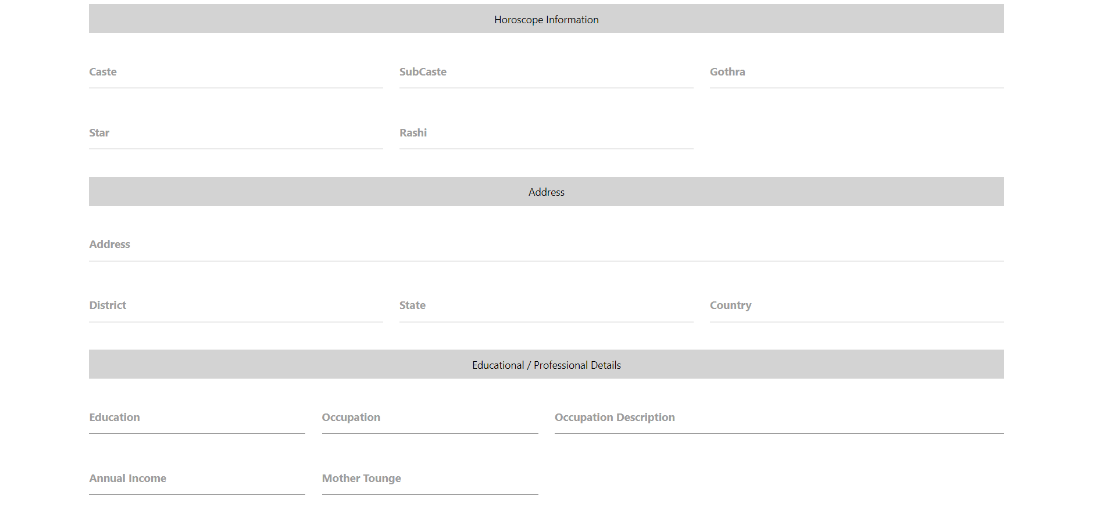

Slide 5
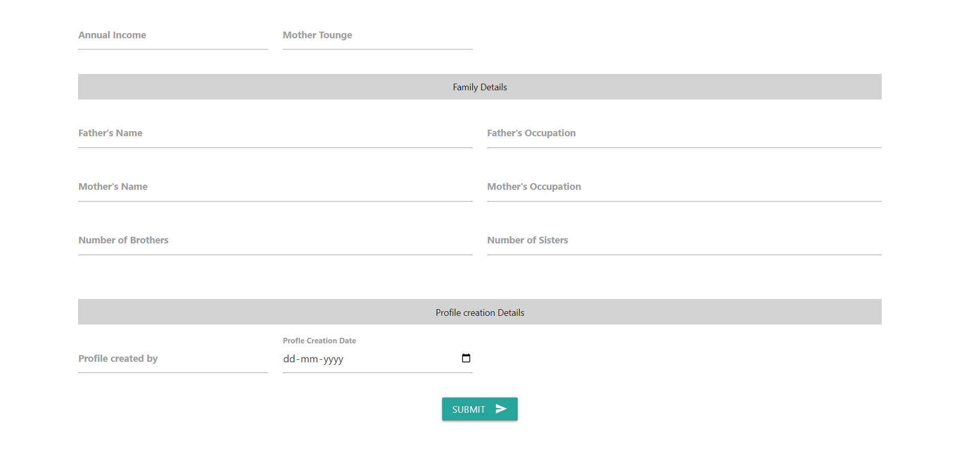

Slide 6
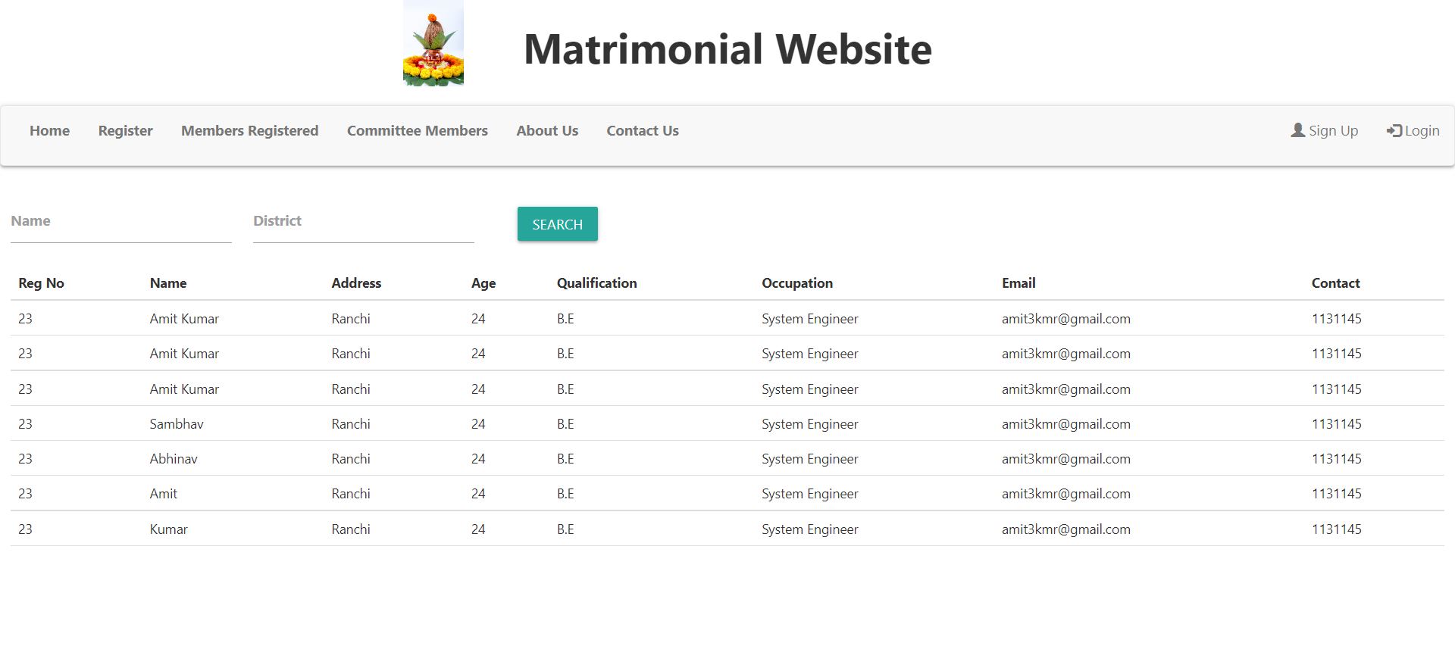
Registered Members

Slide 7
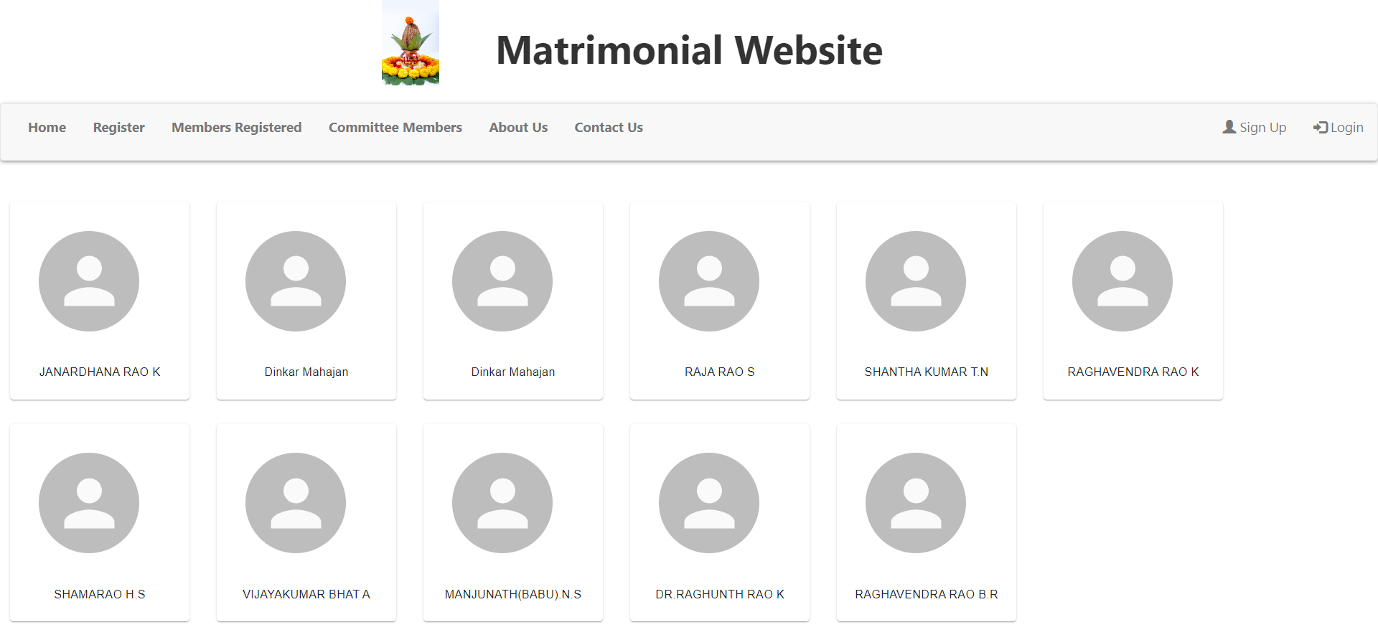
Committee Members

Slide 8

About Us

Slide 9

Contact Us

Slide 10


